Slide 1

Data Science Salary Trends for US Workers – 1Q2023
Rutgers Data Visualization Bootcamp – Group 3
June 2023
June 11, 2023
Data-Related Jobs Salary Predictor app

Slide 2



Agenda
Introduction
Data Cleaning
Data Analysis
Modeling
Predictions
Lessons Learned
June 11, 2023
Data-Related Jobs Salary Predictor app
2

Slide 3




Introduction
The aim of this project was to create a model and app to predict salary of data science jobs in the US based on job title.
Data source: Self-reported data from employees to aijobs in 1Q2023.
Hypothesis or questions this analysis can visualize or questions the model can answer
June 11, 2023
Data-Related Jobs Salary Predictor app
3

Slide 4

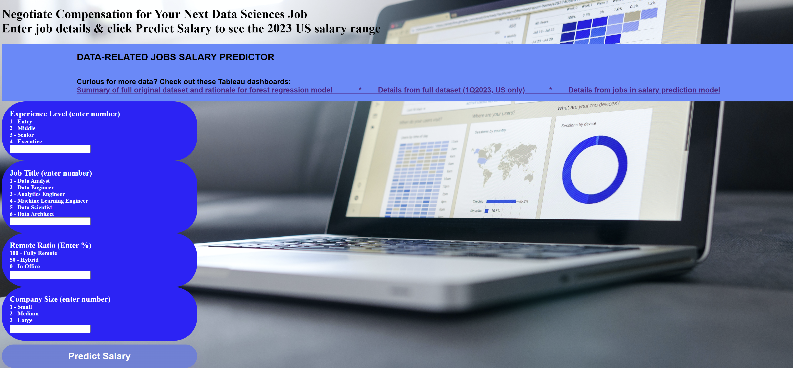
June 11, 2023
Data-Related Jobs Salary Predictor app
4

Slide 5







Tools Used
 | Python | Pandas | Path | Tableau | Scikit-learn | Flask | pickle | HTML | CSS
Cleaning |  | X | X | X
Analysis |  | X | X | X
Visualization |  |  |  | X |  |  |  | X
Modeling |  | X | X |  | X
Website development | X |  |  |  |  | X | X | X | X
Predictions |  |  |  |  | X | X | X | X
June 11, 2023
Data-Related Jobs Salary Predictor app
5

Slide 6





Team
Calogera McCormick
Sana Ayubzai
Minta Burke
Aaron Lilleoien
Tawn Scotton
Select Dataset
Data Cleaning
Data Analysis
Data Modeling
Data Predictions
Project Manager
Data Scientist
Data Engineer
Data Architect
Data Analyst
June 11, 2023
Data-Related Jobs Salary Predictor app
6

Slide 7
Dataset Overview
Original column | Description | FIlter | Modification | In Refined csv | In final model
work_year: | year the salary was paid
employment_type: | type of employment for the role
employee_residence | employee's primary country of residence in during the work year as an ISO 3166 country code
salary: | total gross salary amount paid
salary_currency: | currency of the salary paid as an ISO 4217 currency code
company_location: | country of the employer's main office or contracting branch
experience_level: | experience level in the job during the year
job_title: | role worked in during the year
salaryinusd: | salary in USD
remote_ratio: | overall amount of work done remotely
company_size: | median number of people that worked for the company during the year

Slide 8

Data Cleaning
Used Tableau to visualize full dataset. Identified roles with highest frequency and features (eg, ex-US countries, contractor job type) with low frequency.
Dropped null values and null values.
Identified columns that did not add value & marked for deletion.
Used Python to refine dataset.
Grouped data - combined all job titles into 7 grouped titles (ie, Data Analyst, Data Architect, Data Engineer, Data Manager, Data Scientist, Developer, Other)
Binned data – 8 bins of salary data from <50K to >400K USD
Codified features that were categorical data (eg, experience level updated to 1, 2, 3, 4).
June 11, 2023
Data-Related Jobs Salary Predictor app
8

Slide 9
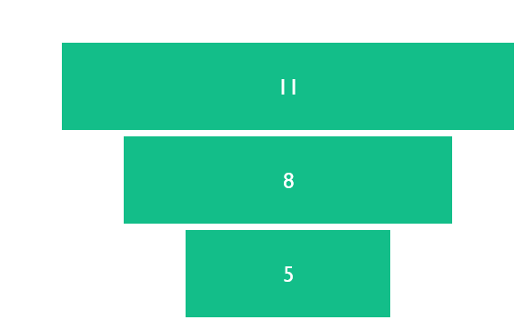
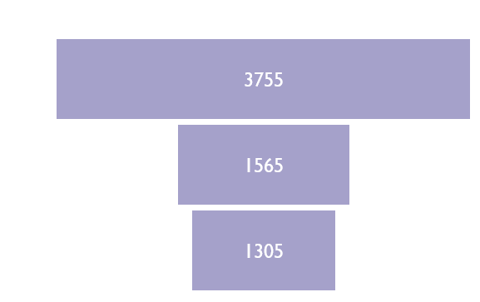
Summary of Data Volume per Step

Slide 10
Dataset Overview
Original column | Description | FIlter | Modification | In Refined csv | In final model
work_year: | year the salary was paid | 2023 | none
employment_type: | type of employment for the role | Full-time | Coded 1 to 2, then dropped contractors | X
employee_residence | employee's primary country of residence in during the work year as an ISO 3166 country code | US | none
salary: | total gross salary amount paid | Dropped
salary_currency: | currency of the salary paid as an ISO 4217 currency code | Dropped
company_location: | country of the employer's main office or contracting branch | Dropped
experience_level: | experience level in the job during the year | All included | Coded 1 to 4 | X | X
job_title: | role worked in during the year | All included | Grouped and coded 1 to 8; dropped some; regrouped and recoded 1 to 6 | X | X
salaryinusd: | salary in USD | Included | Binned and coded 1 to 8, then 1-4 | X | X
remote_ratio: | overall amount of work done remotely | Included | none | X | X
company_size: | median number of people that worked for the company during the year | Included | Coded, 1 to 3 | X | X

Slide 11
Data Analysis
Team to complete this slide
Team to complete this slide
Team to complete this slide
Team to complete this slide
Team to complete this slide
June 11, 2023
Data-Related Jobs Salary Predictor app
11

Slide 12
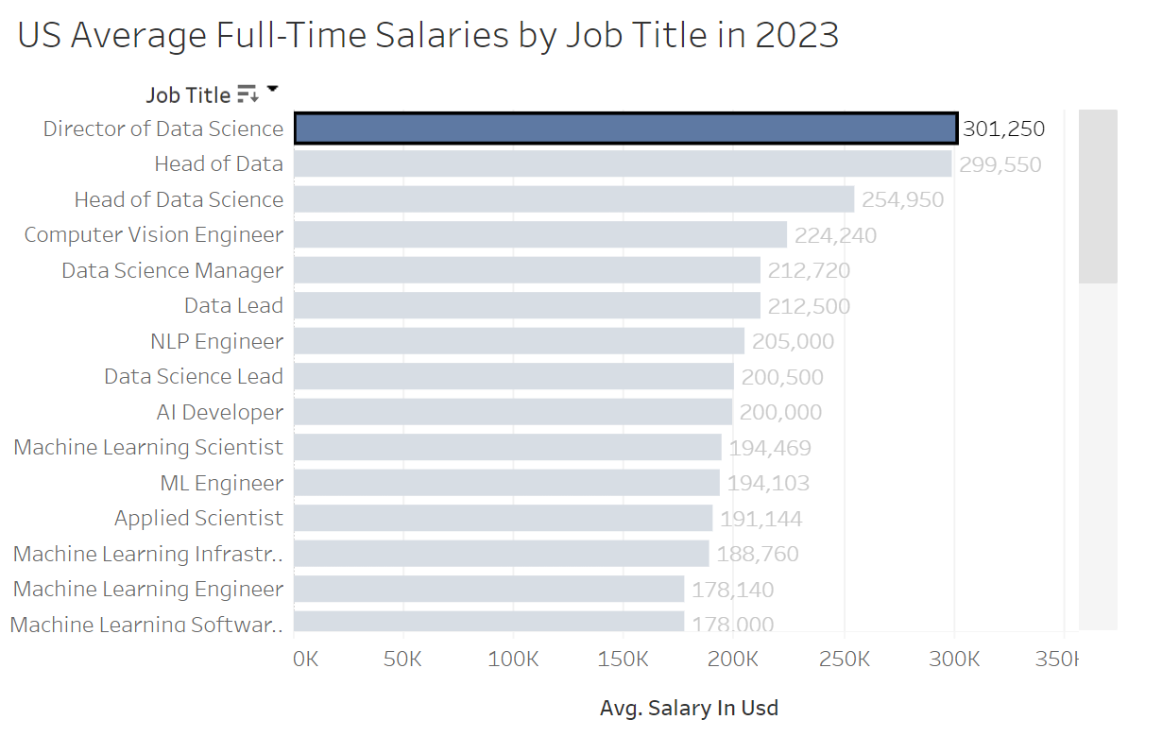
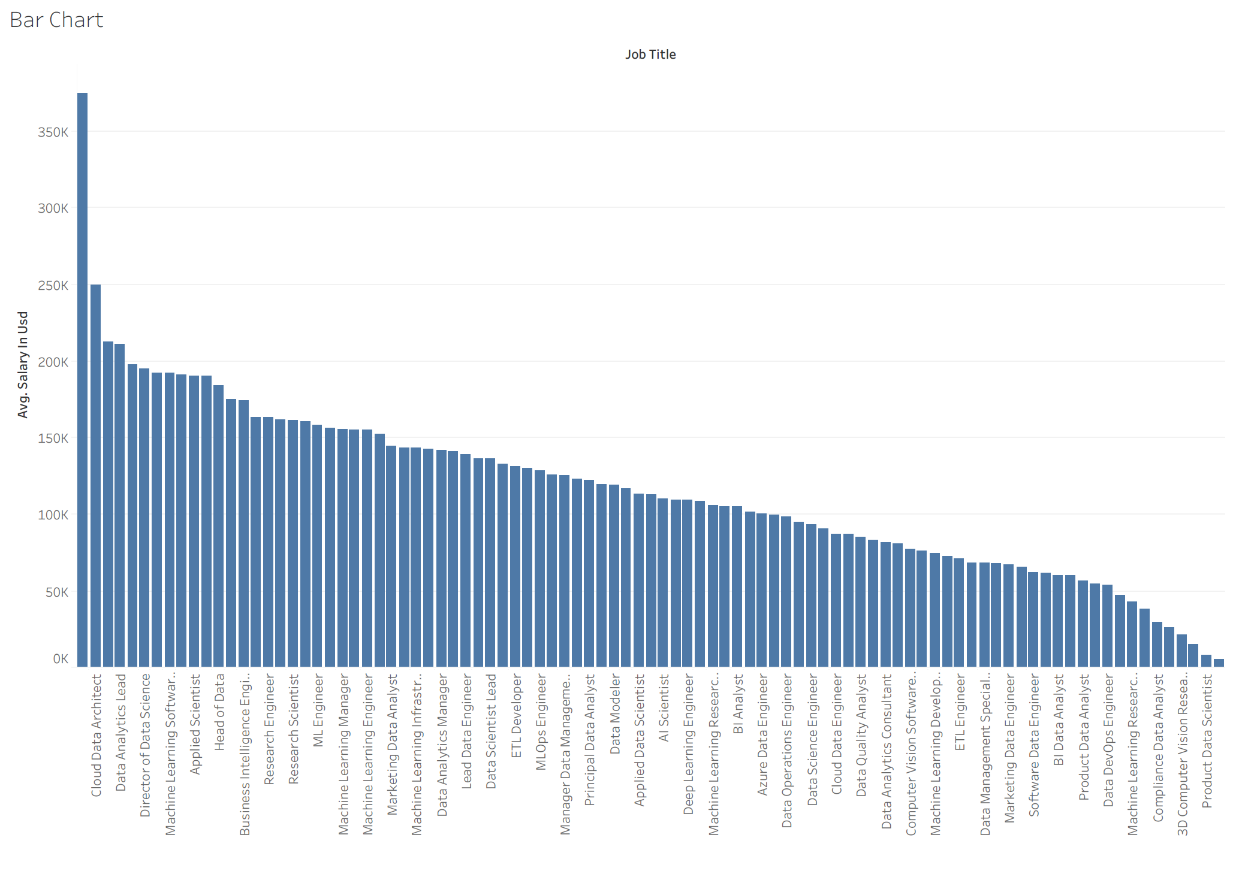
Data Analysis (Original csv Data)
Need a figure that shows total # of rows for each job title in original csv to replace one of these
Average Salary by job title
Average Salary by job title
June 11, 2023
Data-Related Jobs Salary Predictor app
12

Slide 13
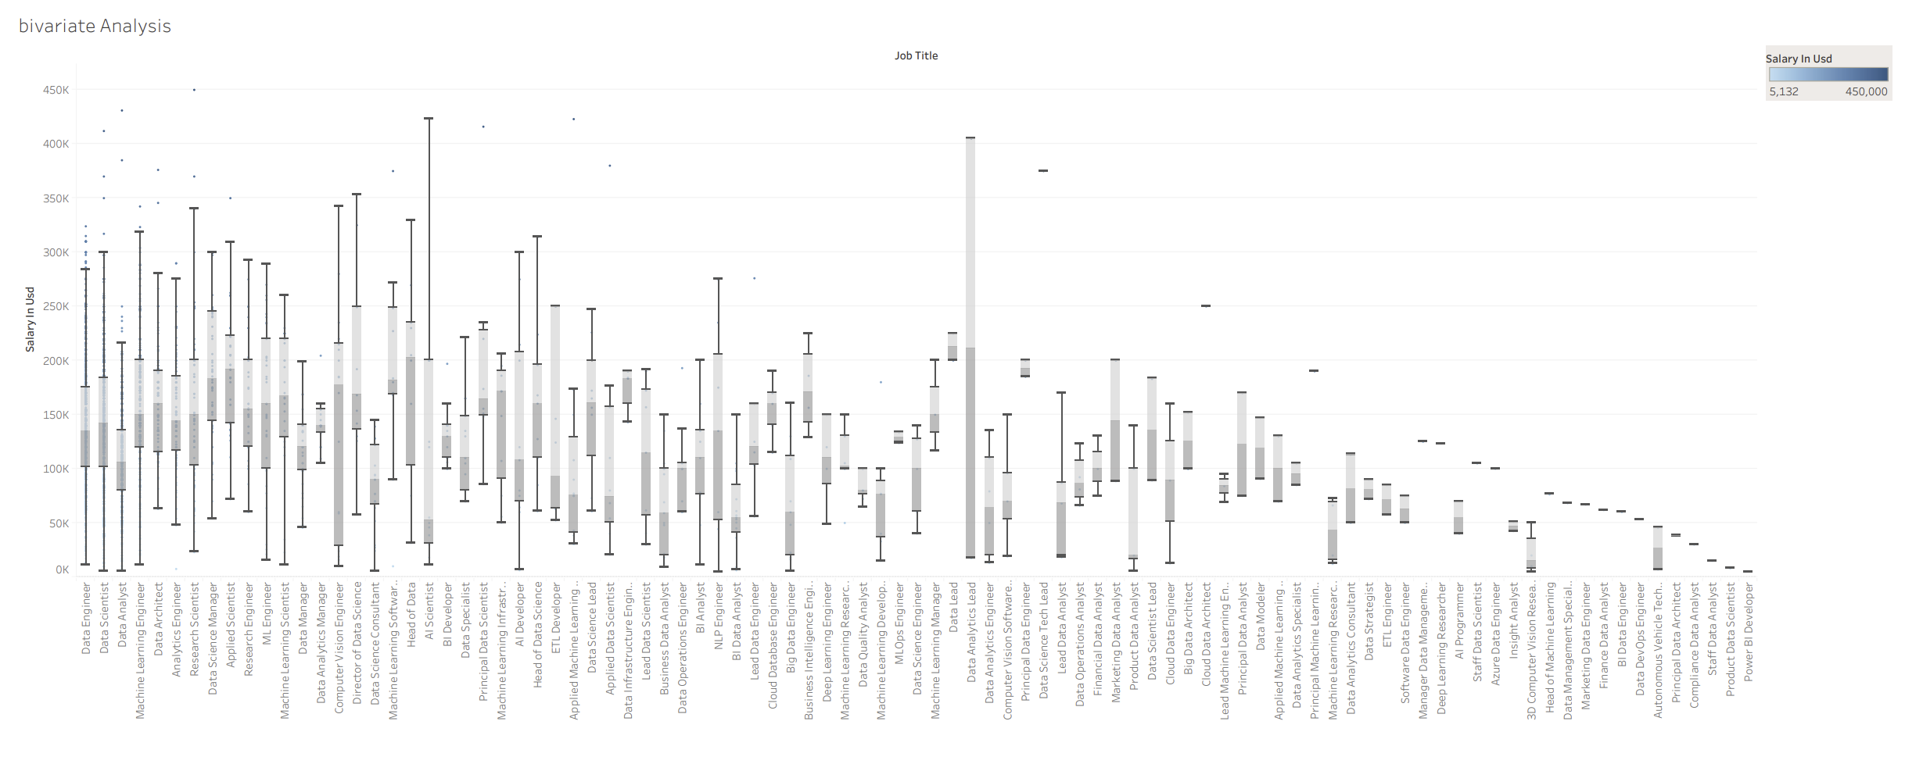
Data Analysis (Original csv Data)
Bivariate Analysis
June 11, 2023
Data-Related Jobs Salary Predictor app
13

Slide 14
Data Modeling
Gathered and prepared the data: Imported the refined csv from the data cleaning.
Split the data into training and test data sets.
Identified the features (job category, experience level, remote ratio, company size) and target variable (ie, salary in USD).
Trained and tested a forest regression model.
Evaluated model and finetuned the model.
Checked that model returned logical predictions based on a variety of input combinations
June 11, 2023
Data-Related Jobs Salary Predictor app
14

Slide 15
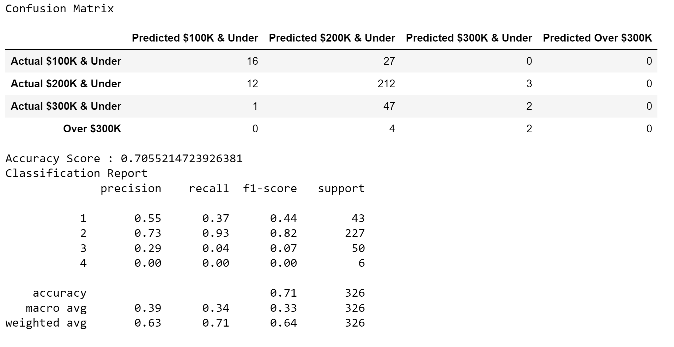
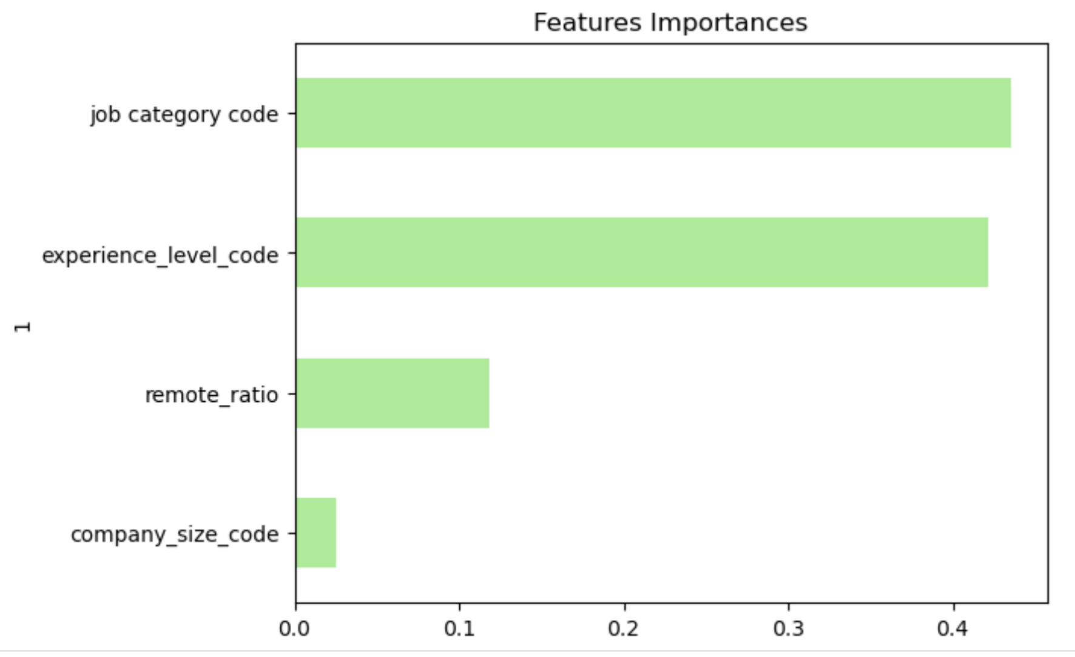
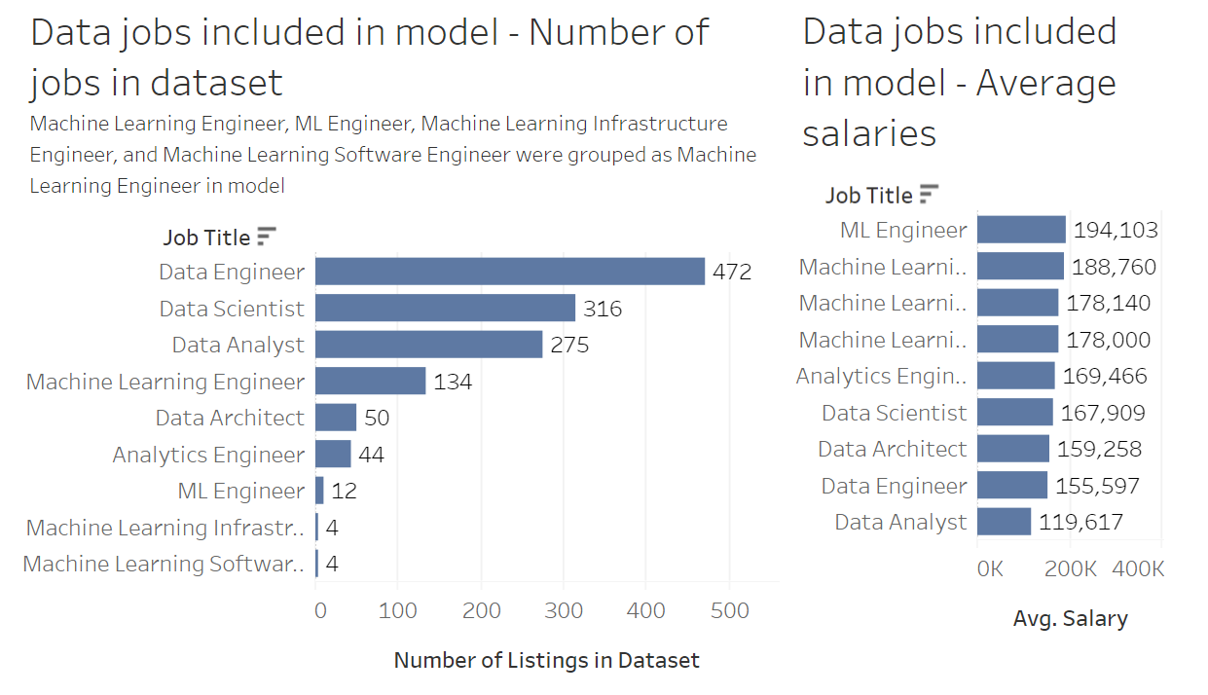
Implementing the Random Forest Model
Model accuracy
Feature importance
Average Salary per job title - model
June 11, 2023
Data-Related Jobs Salary Predictor app
15

Slide 16
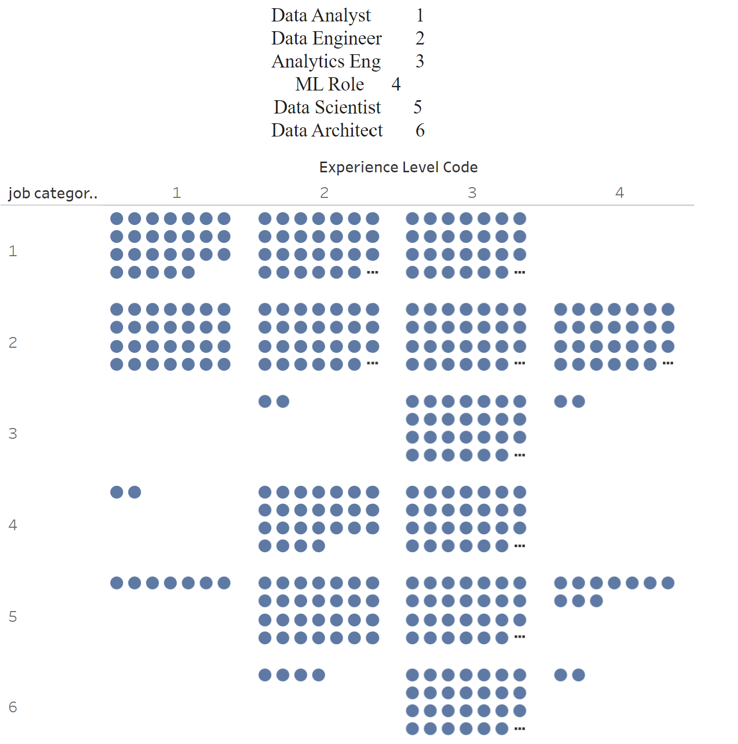
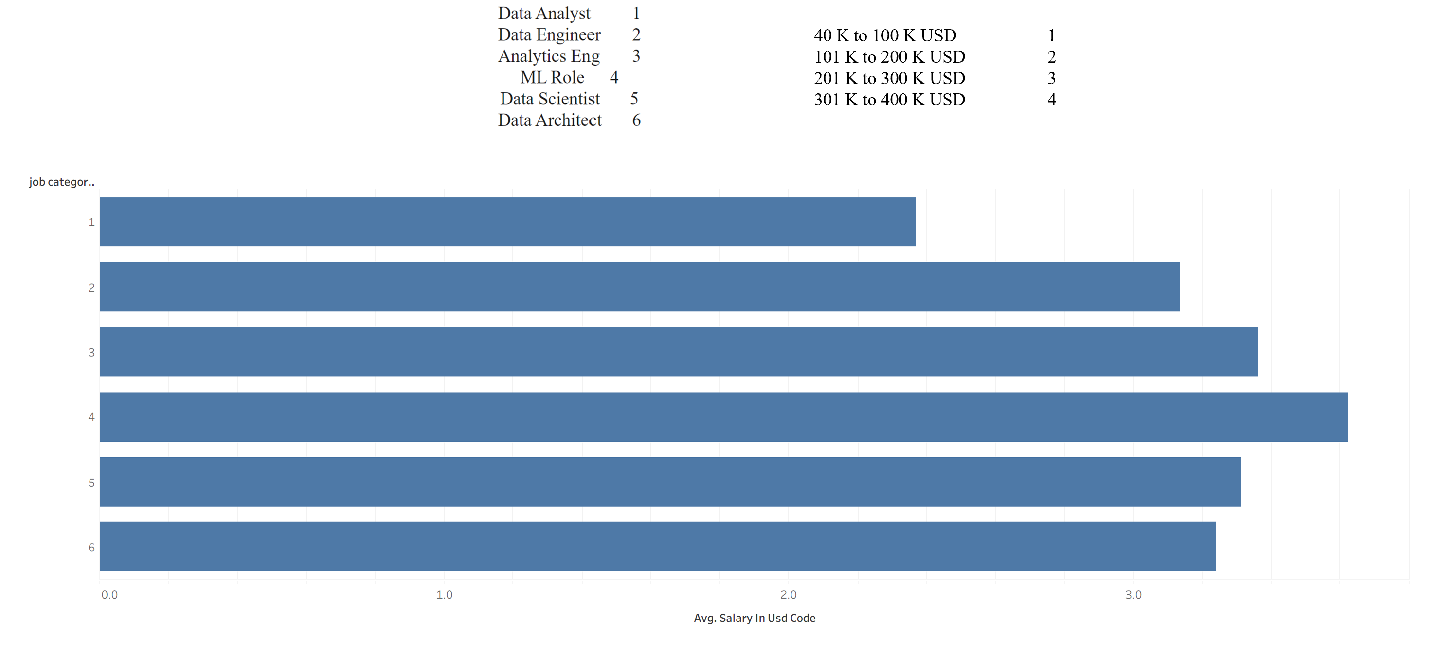
Data Analysis - Model
Average Salary per job title - model
Experience Level frequency per Job Category
June 11, 2023
Data-Related Jobs Salary Predictor app
16

Slide 17
Data Predictions
Used Flask, HTML and CSS to build a user interface to get salary predictions based on user input.
Refined the coding to optimize appropriate flow and navigation among website pages (eg, included error messages for data entry validation, button to return to calculator from prediction and tableau pages)
Added pages with supportive data visualizations for users who wanted additional background on the data science employment landscape and the development of the model.
June 11, 2023
Data-Related Jobs Salary Predictor app
17

Slide 18
App Files
 | Number of files | Type
app.py | 1 | Python
index |  | HTML
results |  | HTML
 |  | HTML
June 11, 2023
Data-Related Jobs Salary Predictor app
18

Slide 19
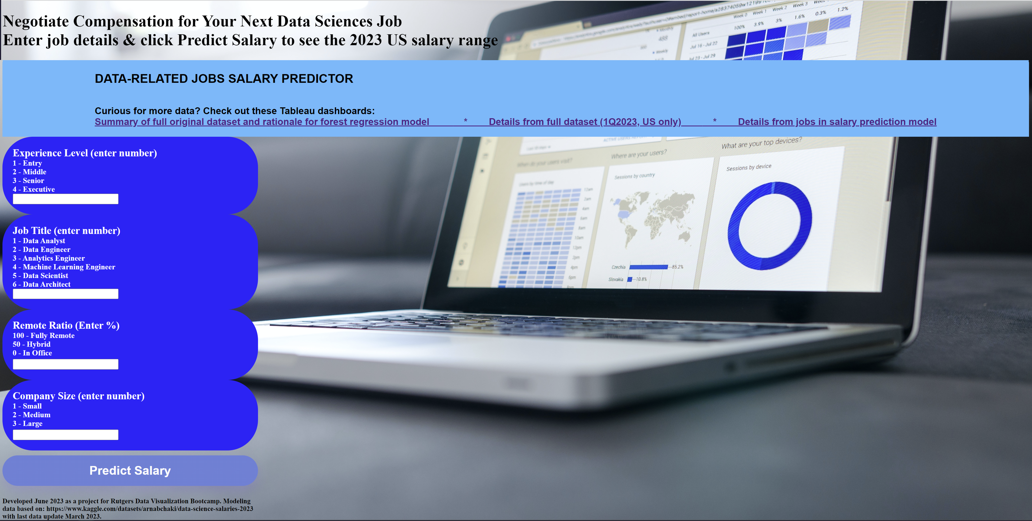
Data-Related Jobs Salary Predictor app - Landing Page

Slide 20
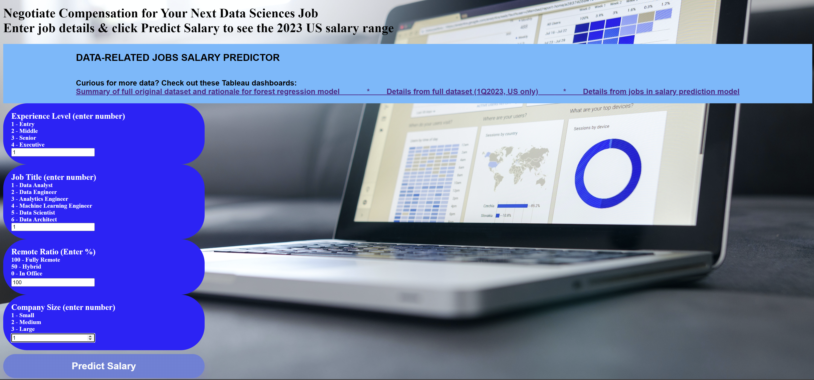
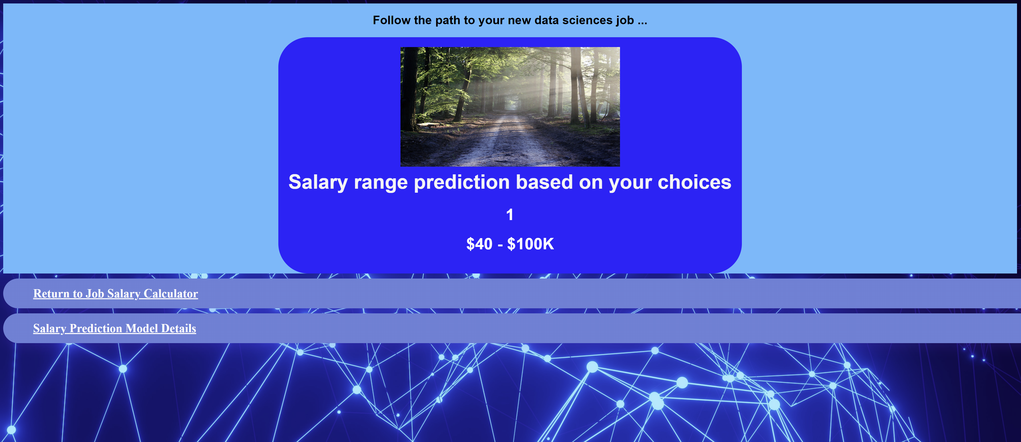
Data Entry & Results Prediction
Data Entry
Entry level, data analyst, 100% remote, small company
Results Prediction
Predicted salary between 40-100K USD

Slide 21
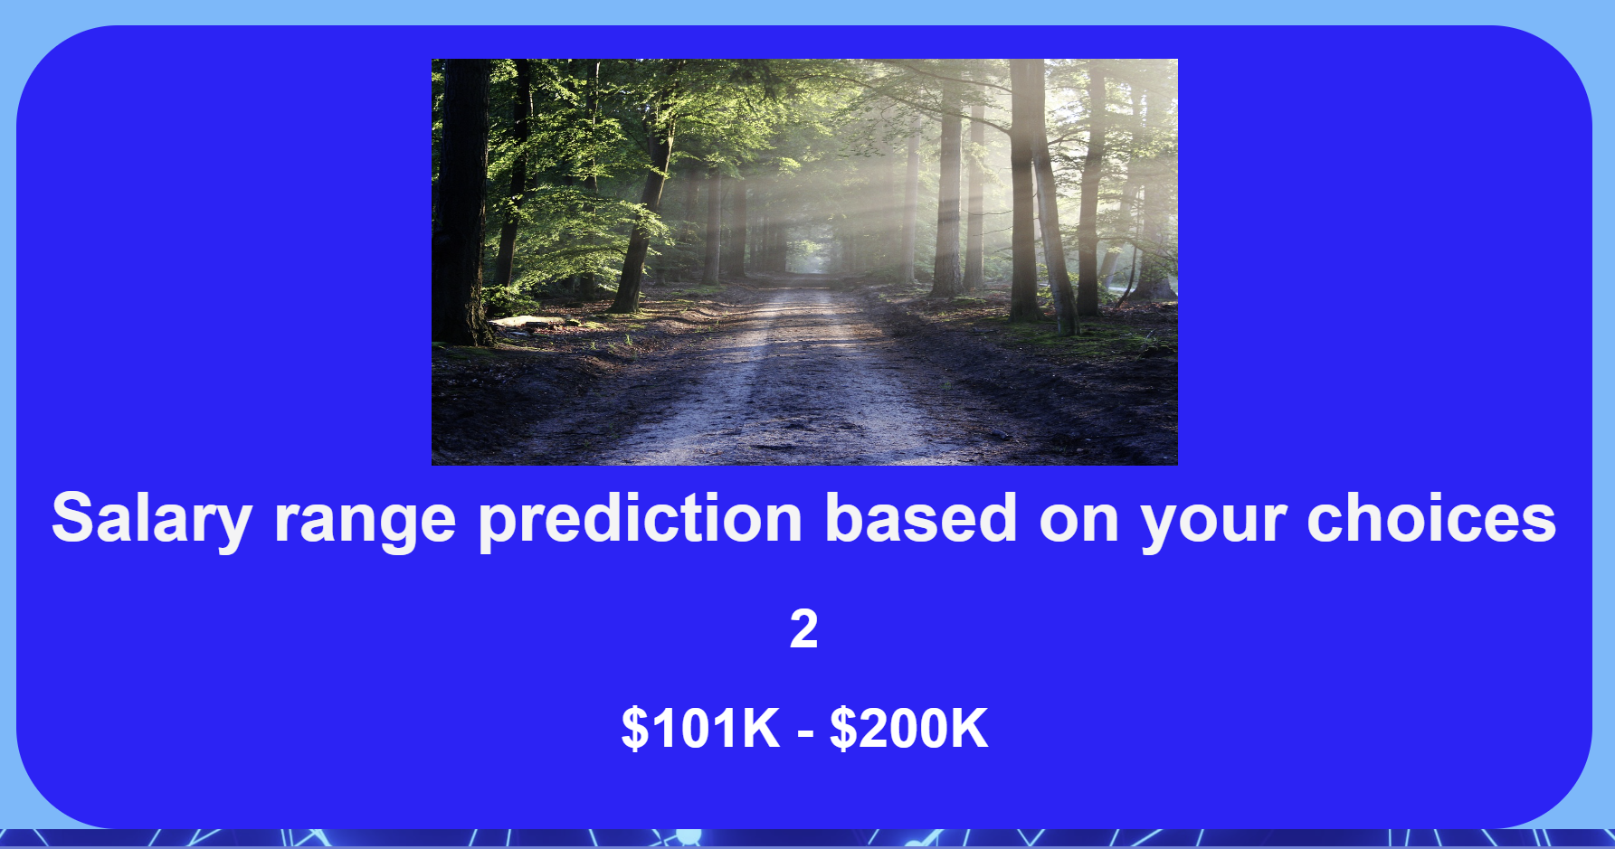
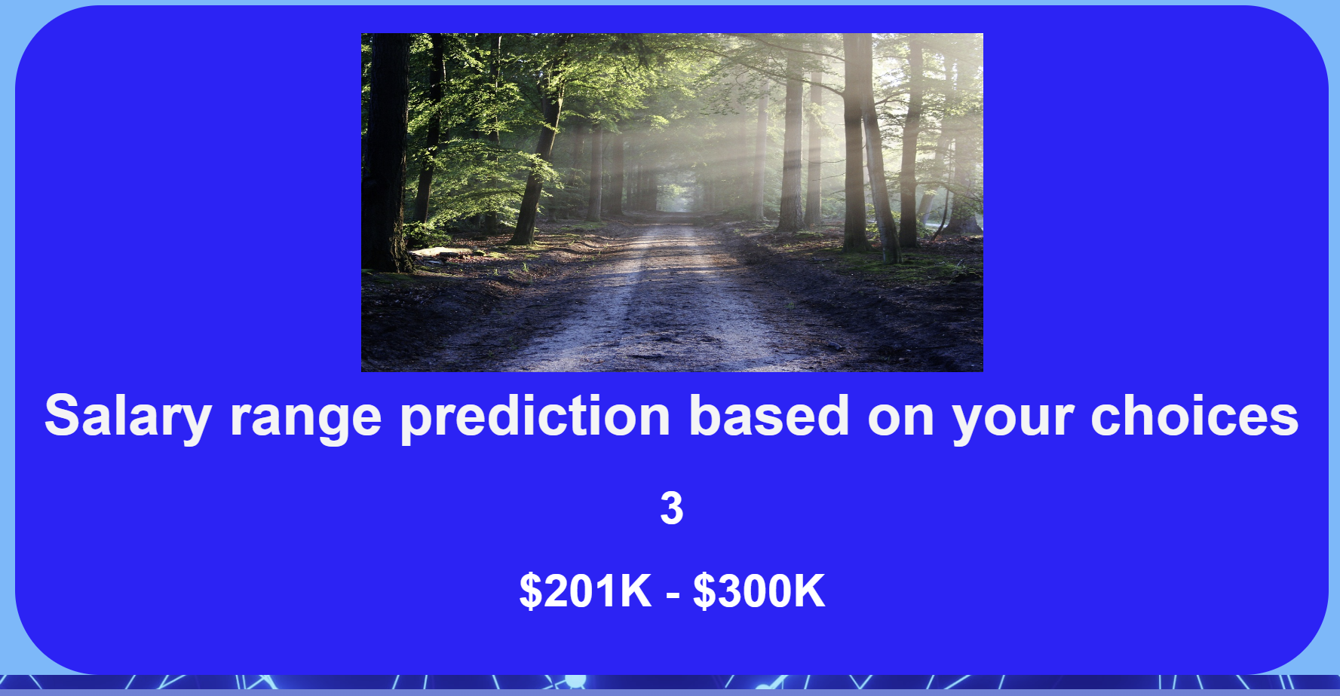
Sample Salary Predictions
Mid level, data engineer,
50% remote, mid-size company
Senior level, data scientist,
50% remote, large company
XXX level, machine learning engineer,
XX% remote, XX company

Slide 22
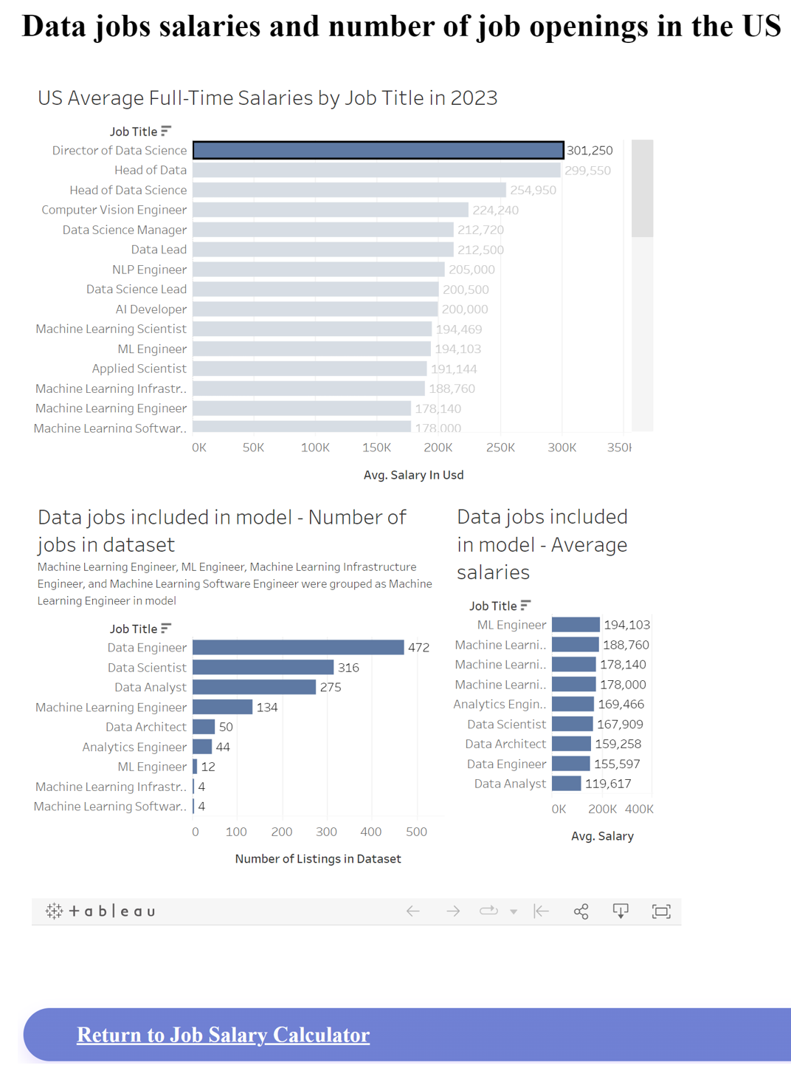
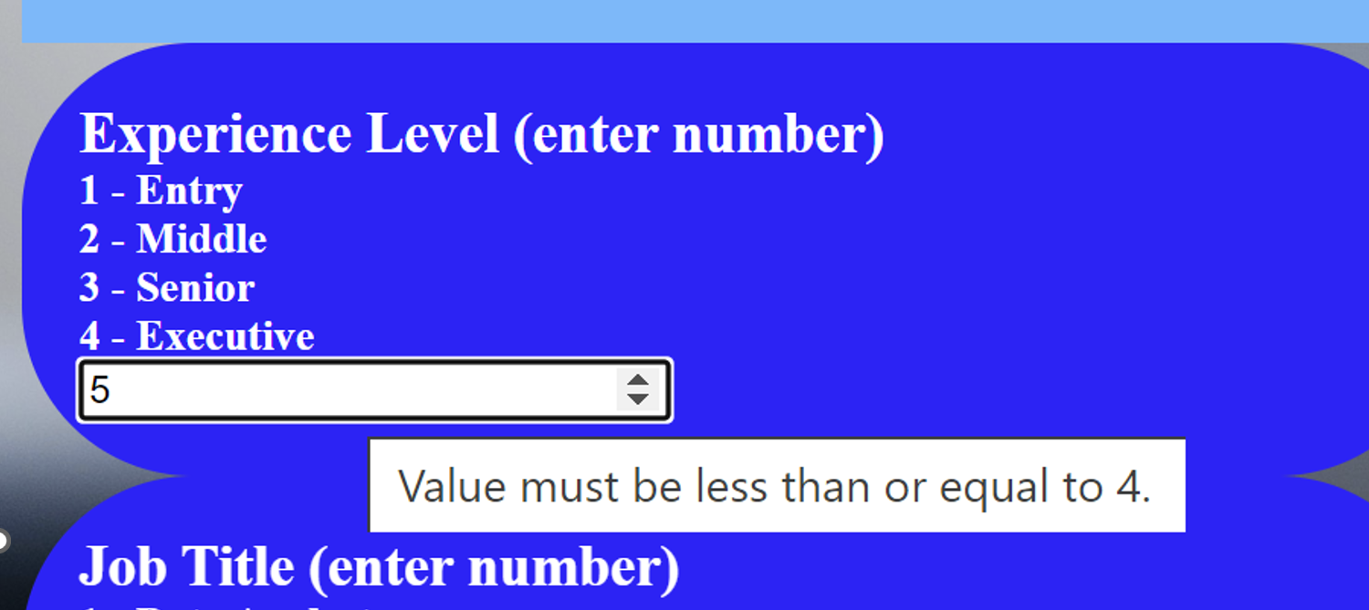
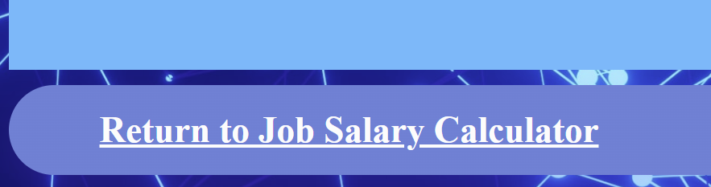
App Navigation and User Experience
Error on the data entry form prompting user for appropriate data entry within prespecificed parameters
Example of tableau visualization from one of the pages user can navigate to for supporting data
Button to return to calculator from the predictions results page

Slide 23
Summary
With PowerPoint, you can create presentations and share your work with others, wherever they are. Type the text you want here to get started. You can also add images, art, and videos on this template. Save to OneDrive and access your presentations from your computer, tablet, or phone.
June 11, 2023
Data-Related Jobs Salary Predictor app
23

Slide 24
Lessons Learned
A few lessons learned here
And here
Refine scope of our questions based on time constraints. Model built to predict salary based on inputs. We did not complete the additional models to predict job title or experience level based on salary.
June 11, 2023
Data-Related Jobs Salary Predictor app
24

Slide 25

Ready to negotiate salary for your new data science position… this app is here to help. Know your worth. You are your best advocate.
June 11, 2023
Data-Related Jobs Salary Predictor app
25

Slide 26
Data Sources
Original dataset: https://www.kaggle.com/datasets/arnabchaki/data-science-salaries-2023
June 11, 2023
Data-Related Jobs Salary Predictor app
26

Slide 27


Thank You
Presenter name
Email address
Github address
June 11, 2023
Data-Related Jobs Salary Predictor app
27

